Slide 1
CS 152 Computer Architecture and Engineering CS252 Graduate Computer Architecture Lecture 6 – Memory II
Krste Asanovic
Electrical Engineering and Computer Sciences
University of California at Berkeley
http://www.eecs.berkeley.edu/~krste
http://inst.eecs.berkeley.edu/~cs152

Slide 2
Last time in Lecture 6
Dynamic RAM (DRAM) is main form of main memory storage in use today
Holds values on small capacitors, need refreshing (hence dynamic)
Slow multi-step access: precharge, read row, read column
Static RAM (SRAM) is faster but more expensive
Used to build on-chip memory for caches
Cache holds small set of values in fast memory (SRAM) close to processor
Need to develop search scheme to find values in cache, and replacement policy to make space for newly accessed locations
Caches exploit two forms of predictability in memory reference streams
Temporal locality, same location likely to be accessed again soon
Spatial locality, neighboring location likely to be accessed soon

Slide 3
Recap: Replacement Policy
In an associative cache, which line from a set should be evicted when the set becomes full?
Random
Least-Recently Used (LRU)
LRU cache state must be updated on every access
True implementation only feasible for small sets (2-way)
Pseudo-LRU binary tree often used for 4-8 way
First-In, First-Out (FIFO) a.k.a. Round-Robin
Used in highly associative caches
Not-Most-Recently Used (NMRU)
FIFO with exception for most-recently used line or lines
This is a second-order effect. Why?
Replacement only happens on misses
Notes:
NLRU used in Alpha TLBs (jse)

Slide 4
Pseudo-LRU Binary Tree
For 2-way cache, on a hit, single LRU bit is set to point to other way
For 4-way cache, need 3 bits of state. On cache hit, on path down tree, set all bits to point to other half. On miss, bits say which way to replace
1
0
1
0
1
0
Way 3
Way 2
Way 1
Way 0

Slide 5
CPU-Cache Interaction (5-stage pipeline)
0x4
Add
E
Decode,
Register
Fetch
M
A
we
Y
addr
bubble
ALU
Y
IR
B
Primary
Data
Cache
rdata
PC
addr
inst
D
R
hit?
wdata
hit?
wdata
PCen
Primary
Instruction
Cache
MD1
MD2
Stall entire CPU on data cache miss
To Memory Control
Cache Refill Data from Lower Levels of Memory Hierarchy
Notes:
How are writes to istream handled?

Slide 6
Improving Cache Performance
Average memory access time (AMAT) =
Hit time + Miss rate x Miss penalty
To improve performance:
reduce the hit time
reduce the miss rate
reduce the miss penalty
What is best cache design for 5-stage pipeline?
Biggest cache that doesn’t increase hit time past 1 cycle (approx 8-32KB in modern technology)
[ design issues more complex with deeper pipelines and/or out-of-order superscalar processors]
Notes:
Design the largest primary cache without slowing down the clock
Or adding pipeline stages.

Slide 7
Causes of Cache Misses: The 3 C’s
Compulsory: first reference to a line (a.k.a. cold start misses)
misses that would occur even with infinite cache
Capacity: cache is too small to hold all data needed by the program
misses that would occur even under perfect replacement policy
Conflict: misses that occur because of collisions due to line-placement strategy
misses that would not occur with ideal full associativity

Slide 8
Effect of Cache Parameters on Performance
Larger cache size
reduces capacity and conflict misses
hit time will increase
Higher associativity
reduces conflict misses
may increase hit time
Larger line size
reduces compulsory and capacity (reload) misses
increases conflict misses and miss penalty
Notes:
Requested line first….
The following could be in the slide…
spatial locality reduces compulsory misses and capacity reload misses
fewer lines may increase conflict miss rate
larger lines may increase miss penalty

Slide 9
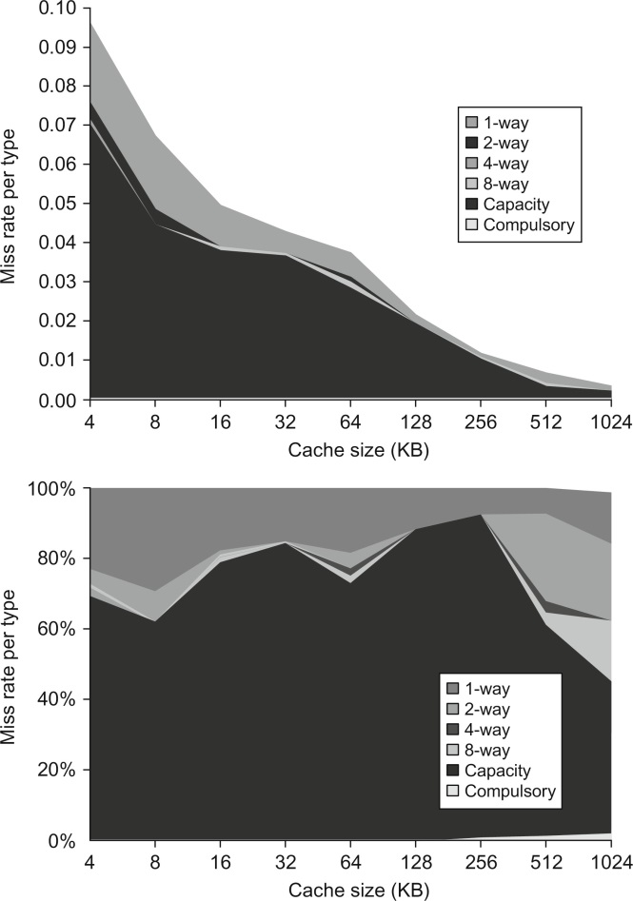
Figure B.9 Total miss rate (top) and distribution of miss rate (bottom) for each size cache according to the three C's for the data in Figure B.8. The top diagram shows the actual data cache miss rates, while the bottom diagram shows the percentage in each category. (Space allows the graphs to show one extra cache size than can fit in Figure B.8.)
© 2018 Elsevier Inc. All rights reserved.

Slide 10
Recap: Line Size and Spatial Locality
A line is unit of transfer between the cache and memory
4 word line, b=2
Tag
Word0
Word1
Word2
Word3
Split CPU address
Line Address
Offset
32-b bits
b bits
2^{b} = line size a.k.a line size (in bytes)
Larger line size has distinct hardware advantages
less tag overhead
exploit fast burst transfers from DRAM
exploit fast burst transfers over wide busses
What are the disadvantages of increasing line size?
Fewer lines => more conflicts. Can waste bandwidth.
Notes:
Larger line size will reduce compulsory misses (first miss to a line).
Larger lines may increase conflict misses since the number of lines
is smaller.

Slide 11
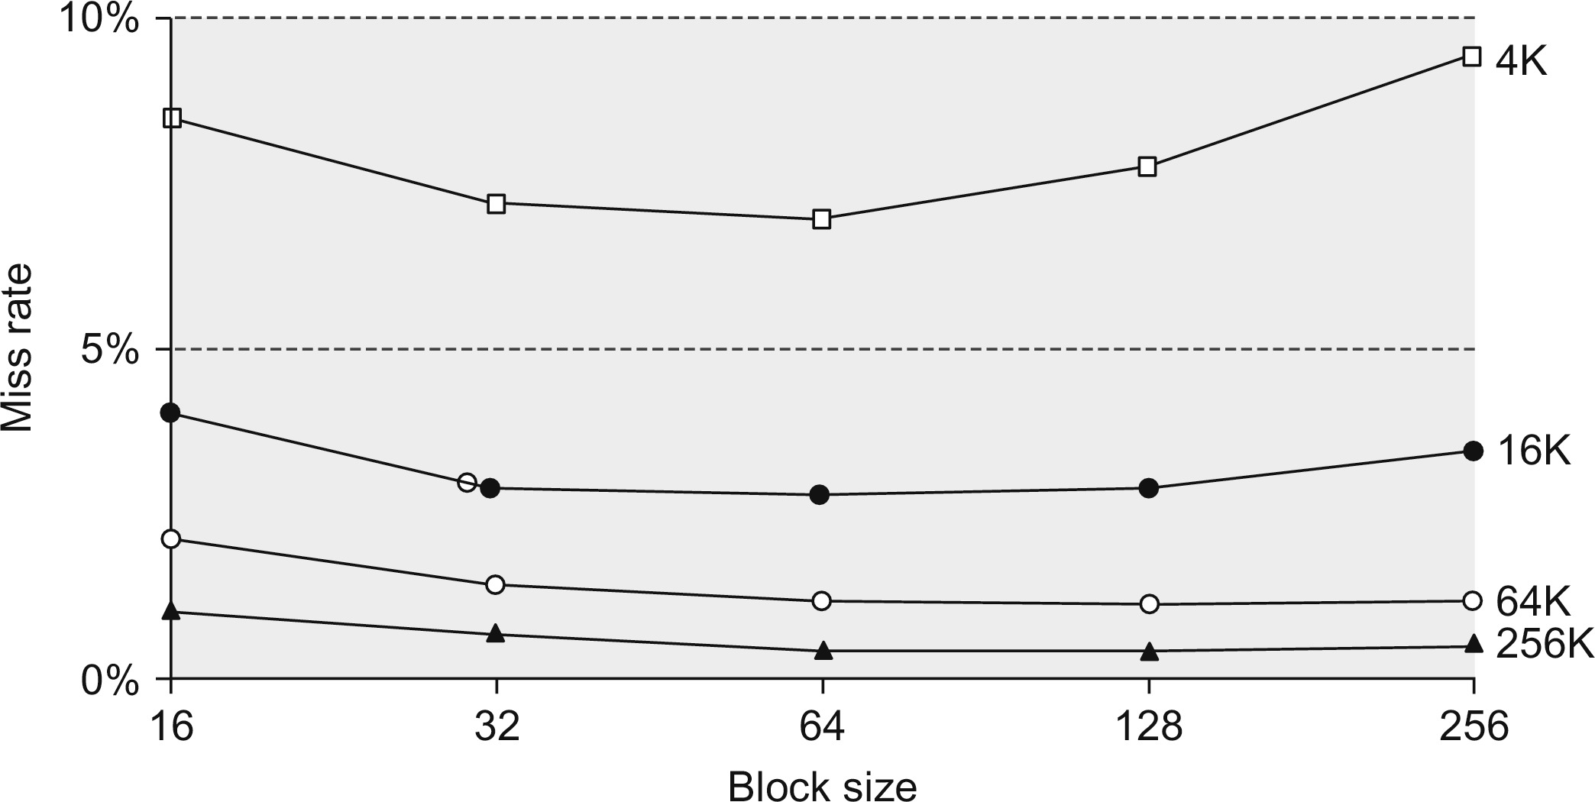
Figure B.10 Miss rate versus block size for five different-sized caches. Note that miss rate actually goes up if the block size is too large relative to the cache size. Each line represents a cache of different size. Figure B.11 shows the data used to plot these lines. Unfortunately, SPEC2000 traces would take too long if block size were included, so these data are based on SPEC92 on a DECstation 5000 (Gee et al. 1993).

Slide 12
Write Policy Choices
Cache hit:
write-through: write both cache & memory
Generally higher traffic but simpler pipeline & cache design
write-back: write cache only, memory is written only when the entry is evicted
A dirty bit per line further reduces write-back traffic
Must handle 0, 1, or 2 accesses to memory for each load/store
Cache miss:
no-write-allocate: only write to main memory
write-allocate (aka fetch-on-write): fetch into cache
Common combinations:
write-through and no-write-allocate
write-back with write-allocate

Slide 13
Write Performance
Tag
Index
Offset
b
t
k
V
Tag
Data
2^{k}
lines
t
=
WE
HIT
Data Word or Byte
Notes:
Completely serial (jse)

Slide 14
Reducing Write Hit Time
Problem: Writes take two cycles in memory stage, one cycle for tag check plus one cycle for data write if hit
Solutions:
Design data RAM that can perform read and write in one cycle, restore old value after tag miss
Pipelined writes: Hold write data for store in single buffer ahead of cache, write cache data during next store’s tag check
Fully-associative (CAM Tag) caches: Word line only enabled if hit
Notes:
Need to bypass from write buffer if read address matches write buffer tag!

Slide 15
Pipelining Cache Writes
Address and Store Data From CPU
Tag
Index
Store Data
Delayed Write Addr.
Delayed Write Data
Load/Store
=?
Tags
S
Data
L
=?
1
0
Load Data to CPU
Hit?
Data from a store hit is written into data portion of cache during tag access of subsequent store

Slide 16
CS152 Administrivia
PS 1 due 11:59PM today!
Solutions discussed in section on Friday
Lab 1 due 11:59PM Wed Feb 17
PS 2 out on Wednesday
Wednesday: Special guest lecture on prefetching from Apple CPU designers
Monday Feb 15 is President’s Day Holiday, no class!

Slide 17
CS252 Administrivia
Start thinking of class projects and forming teams of two
Use Krste’s office hours to discuss ideas
Proposal due Wednesday February 24th

Slide 18
Write Buffer to Reduce Read Miss Penalty
Unified L2 Cache
Data Cache
CPU
RF
Write
buffer
Evicted dirty lines for write-back cache
OR
All writes in write-through cache
Processor is not stalled on writes, and read misses can go ahead of write to main memory
Problem: Write buffer may hold updated value of location needed by a read miss
Simple solution: on a read miss, wait for the write buffer to go empty
Faster solution: Check write buffer addresses against read miss addresses, if no match, allow read miss to go ahead of writes, else, return value in write buffer
Notes:
Deisgners of the MIPS M/1000 estimated that waiting for a four-word buffer to empty
increased the read miss penalty by a factor of 1.5.

Slide 19
Reducing Tag Overhead with Sub-Blocks
Problem: Tags are too large, i.e., too much overhead
Simple solution: Larger lines, but miss penalty could be large.
Solution: Sub-block placement (aka sector cache)
A valid bit added to units smaller than full line, called sub-blocks
Only read a sub-block on a miss
If a tag matches, is the word in the cache?
100
300
204
1 1 1 1
1 0 0
0 1 0 1
Notes:
Main reason for subblock placement is to reduce tag overhead.
Sector cache (jse)

Slide 20
Multilevel Caches
Problem: A memory cannot be large and fast
Solution: Increasing sizes of cache at each level
DRAM
CPU
L2$
L1$
Local miss rate = misses in cache / accesses to cache
Global miss rate = misses in cache / CPU memory accesses
Misses per instruction = misses in cache / number of instructions
Notes:
MPI makes it easier to compute overall performance (jse)

Slide 21
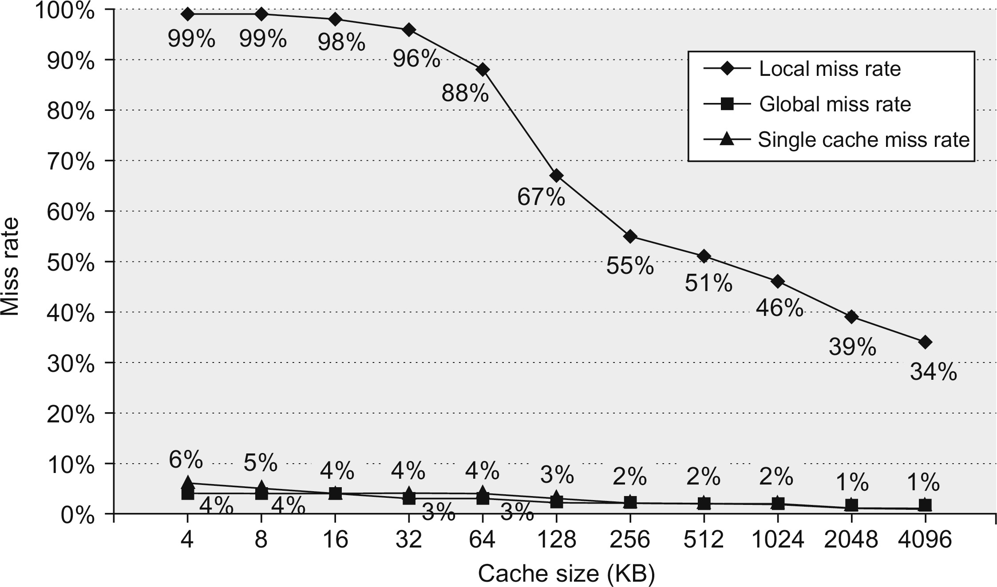
Figure B.14 Miss rates versus cache size for multilevel caches. Second-level caches smaller than the sum of the two 64 KiB first-level caches make little sense, as reflected in the high miss rates. After 256 KiB the single cache is within 10% of the global miss rates. The miss rate of a single-level cache versus size is plotted against the local miss rate and global miss rate of a second-level cache using a 32 KiB first-level cache. The L2 caches (unified) were two-way set associative with replacement. Each had split L1 instruction and data caches that were 64 KiB two-way set associative with LRU replacement. The block size for both L1 and L2 caches was 64 bytes. Data were collected as in Figure B.4.

Slide 22
Presence of L2 influences L1 design
Use smaller L1 if there is also L2
Trade increased L1 miss rate for reduced L1 hit time
Backup L2 reduces L1 miss penalty
Reduces average access energy
Use simpler write-through L1 with on-chip L2
Write-back L2 cache absorbs write traffic, doesn’t go off-chip
At most one L1 miss request per L1 access (no dirty victim write back) simplifies pipeline control
Simplifies coherence issues
Simplifies error recovery in L1 (can use just parity bits in L1 and reload from L2 when parity error detected on L1 read)

Slide 23
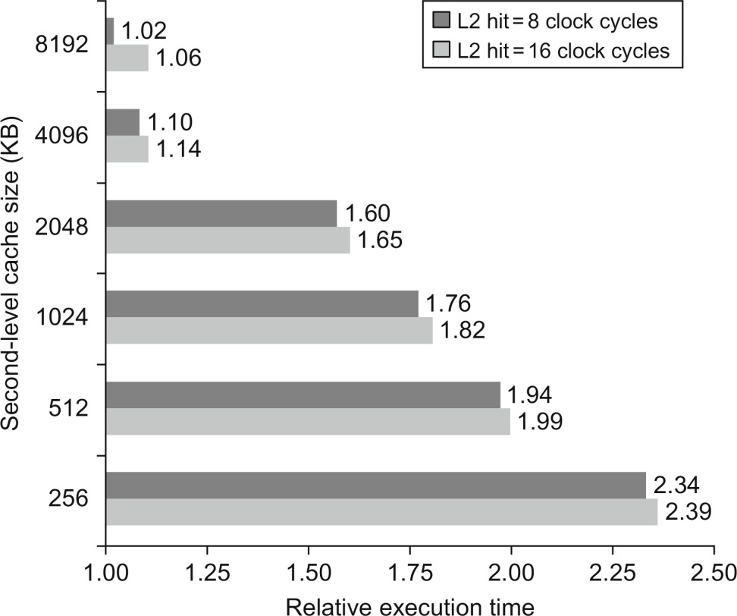
Figure B.15 Relative execution time by second-level cache size. The two bars are for different clock cycles for an L2 cache hit. The reference execution time of 1.00 is for an 8192 KiB second-level cache with a 1-clock-cycle latency on a second-level hit. These data were collected the same way as in Figure B.14, using a simulator to imitate the Alpha 21264.

Slide 24
Inclusion Policy
Inclusive multilevel cache:
Inner cache can only hold lines also present in outer cache
External coherence snoop access need only check outer cache
Exclusive multilevel caches:
Inner cache may hold lines not in outer cache
Swap lines between inner/outer caches on miss
Used in AMD Athlon with 64KB primary and 256KB secondary cache
Why choose one type or the other?
Notes:
New slide (jse)

Slide 25
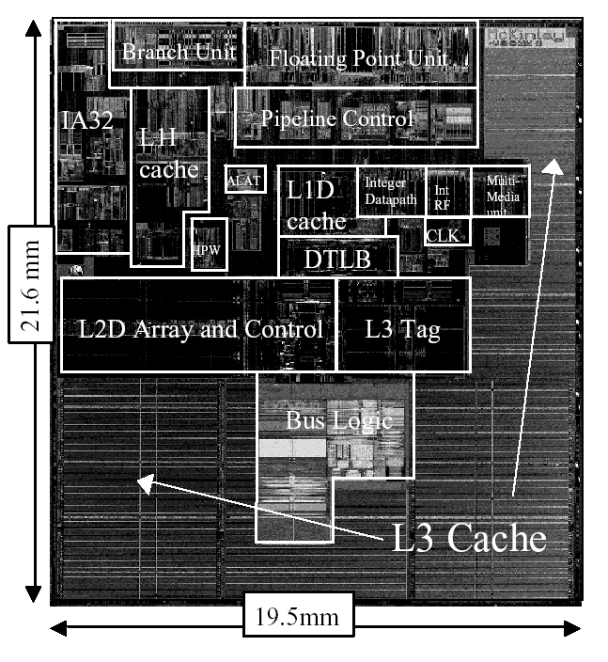
Itanium-2 On-Chip Caches (Intel/HP, 2002)
Level 1: 16KB, 4-way s.a., 64B line, quad-port (2 load+2 store), single cycle latency
Level 2: 256KB, 4-way s.a, 128B line, quad-port (4 load or 4 store), five cycle latency
Level 3: 3MB, 12-way s.a., 128B line, single 32B port, twelve cycle latency
Notes:
If two is good, then three must be better (jse)

Slide 26
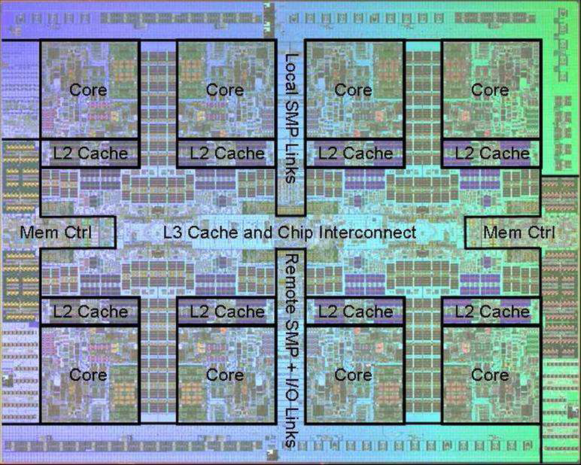
Power 7 On-Chip Caches [IBM 2009]
32KB L1 I$/core
32KB L1 D$/core
3-cycle latency
256KB Unified L2$/core
8-cycle latency
32MB Unified Shared L3$
Embedded DRAM (eDRAM)
25-cycle latency to local slice

Slide 27
IBM z196 Mainframe Caches 2010
96 cores (4 cores/chip, 24 chips/system)
Out-of-order, 3-way superscalar @ 5.2GHz
L1: 64KB I-$/core + 128KB D-$/core
L2: 1.5MB private/core (144MB total)
L3: 24MB shared/chip (eDRAM) (576MB total)
L4: 768MB shared/system (eDRAM)

Slide 28
Acknowledgements
This course is partly inspired by previous MIT 6.823 and Berkeley CS252 computer architecture courses created by my collaborators and colleagues:
Arvind (MIT)
Joel Emer (Intel/MIT)
James Hoe (CMU)
John Kubiatowicz (UCB)
David Patterson (UCB)

